Slide 1

INFO 6105 Data Science Engineering Method and Tools
Team 9 - Vishakha Vinayak, Pranali Vedpathak
USED CAR
PRICE PREDICTION
SYSTEM

Slide 2

ABSTRACT
A car price prediction has been a high interest research area, as it requires noticeable effort and knowledge of the field expert. Considerable number of distinct attributes are examined for the reliable and accurate prediction.
To build a model for predicting the price of used cars the machine learning techniques are used
Respective performances of different algorithms were then compared to find one that best suits the available data set.

Slide 3
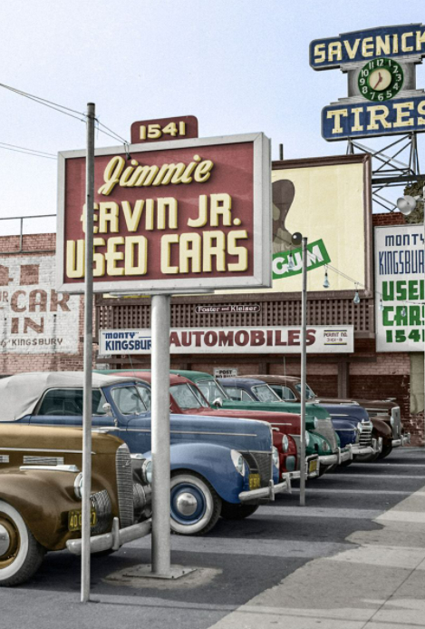
INTRODUCTION
Vehicle price prediction especially when the vehicle is used and not coming direct from the factory, is both a critical and important task. With increase in demand for used cars, more and more vehicle buyers are finding alternatives of buying new cars.
There is a need of accurate price prediction mechanism for the used cars. Prediction techniques of machine learning can be helpful in this regard.
It is common to buy a used car in many countries rather than buying a new one.

Slide 4
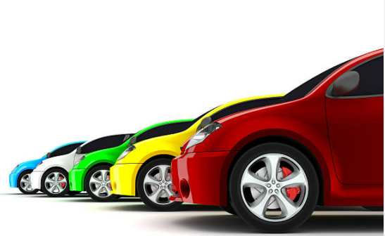
PROJECT OVERVIEW
1
Goal
Predict used car prices based on
various features
Linear Regression
Decision Trees
2
Models
5 Machine Learning Models
Random Forest
Gradient boosting
XGBoost
3
Outcome
Predicted Used Car Prices

Slide 5

DATASET
The dataset is from Kaggle by Austin Reese.
This data is scrapped from craigslist which has the world’s largest collection of used vehicles for sale.
It contains most recent relevant information from Craigslist including columns like price, condition, manufacturer, type and 23 other features provided in the site.
Data size is 1.45 GB consisting of more than 400,000 samples.
Data Source link: https://www.kaggle.com/austinreese/craigslist-carstrucks-data

Slide 6
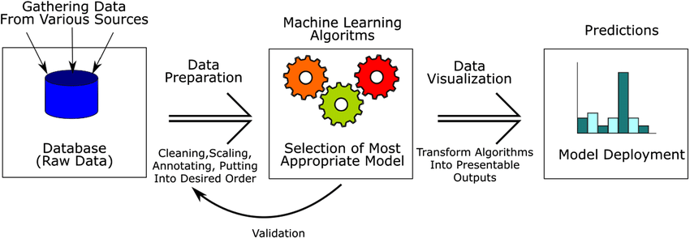
ML FLOW

Slide 7

SOFTWARE AND LIBRARIES USED
Software
Jupyter Notebook
Libraries
Data Manipulation & Visualization: Pandas, Numpy, Matplotlib, Seaborn
Preprocessing: LabelEncoder
Models: LinearRegression, DescisionTreeRegressor, RandomForestRegressor, GradientBoostingRegressor, XGBoostRegressor
Evaluation: Metrics
Data Cleaning: Missingno

Slide 8
EXPLORATORY DATA ANALYSIS
Removed unnecessary features
Handling Missing Values in the dataset
Relationship between various independent and dependent feature(price)

Slide 9
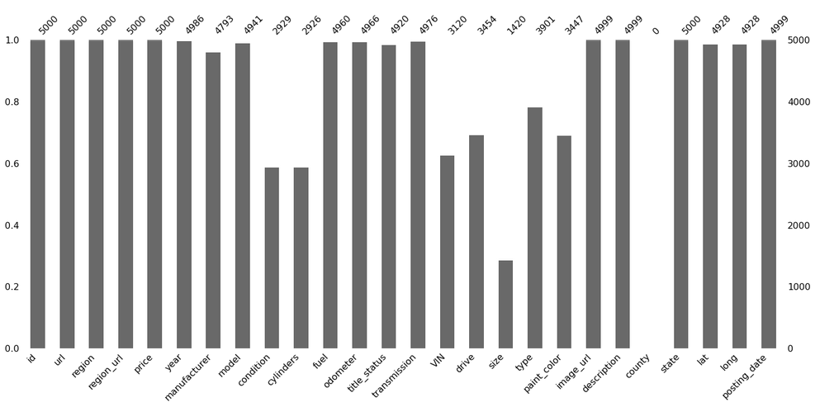
DATA CLEANING & VISUALIZATION

Slide 10
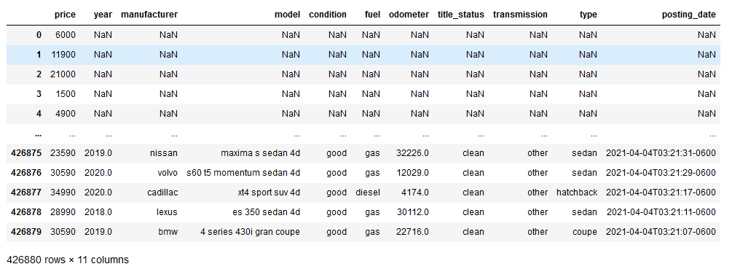
WHAT OUR DATASET LOOKS LIKE?

Slide 11
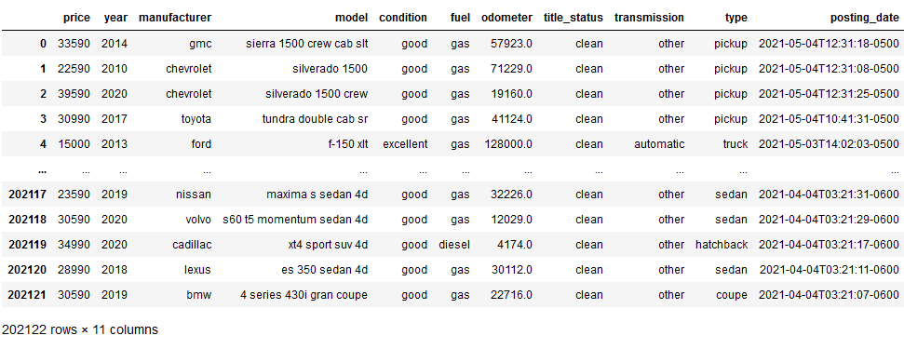
WHAT OUR DATASET LOOKS LIKE?

Slide 12
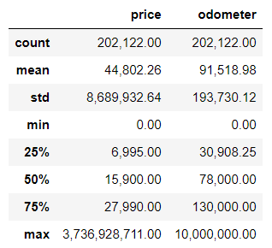
DATA CLEANING & VISUALIZATION
Price:
Price values varies from $0 – $3,736,928,711.00 and mean price is $44,802.26 while odometer ranges from 0 – 10,000,000.00. These values are little realistic so, we are narrowing down the price values between 2k to 50k dollars
vehicles_df.describe() - gives an overview of non-categorical features

Slide 13
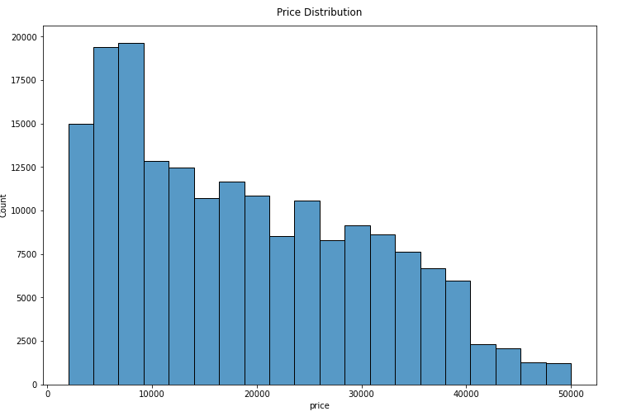
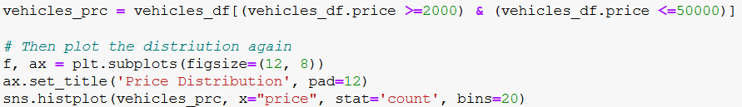
DATA CLEANING & VISUALIZATION

Slide 14
DATA CLEANING & VISUALIZATION
Odometer:
For odometer, it's highly unlikely to run 10 million miles eventually engine will be useless. Analyzing the number entries having 0 and more than 200K odometer values.

Slide 15
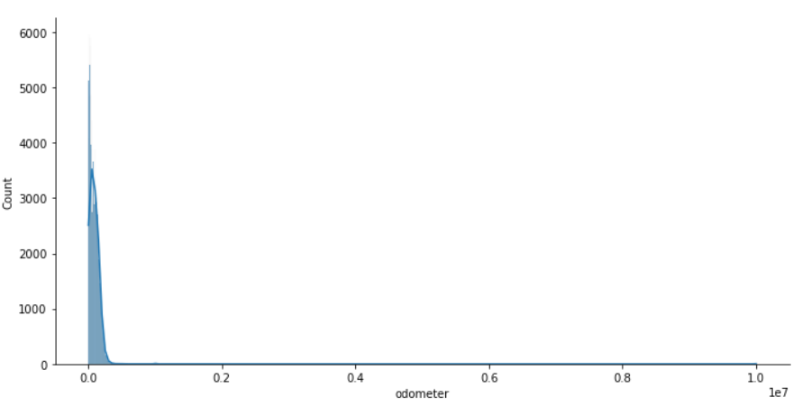
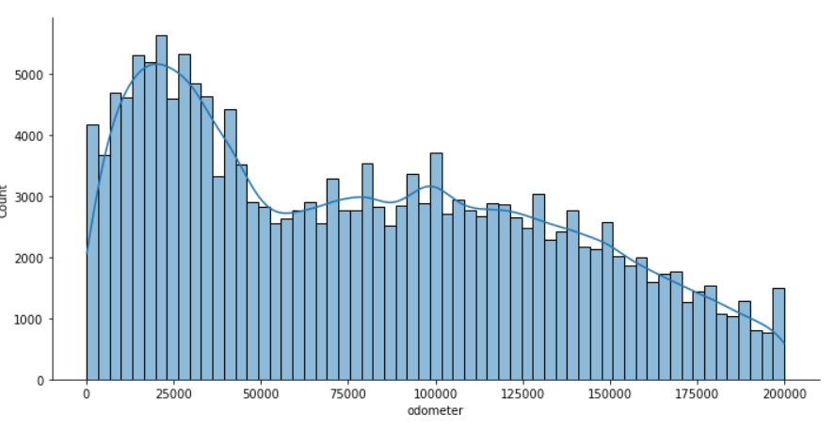
DATA CLEANING & VISUALIZATION
Skewness for Odometer:
There are about 9k values more than 200K which is very less compared to the no of values we have so can be ignored. Based on the above stats, 100 – 200K can be a good dataset. We can verify that, by calculating the skewness for all the data and between 100 to 200K odometer values
Skewness for first figure is 48.58 and for second is 0.37, so our data is evenly distributed around the range we have selected.

Slide 16
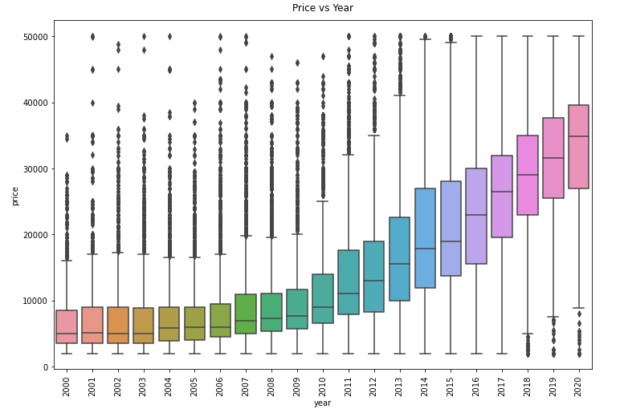
DATA CLEANING & VISUALIZATION
Price vs Year
if we compare the age of the car with price, we can see that as the model becomes older, price decreases. Similarly for the cars that are driven more are less expensive.

Slide 17
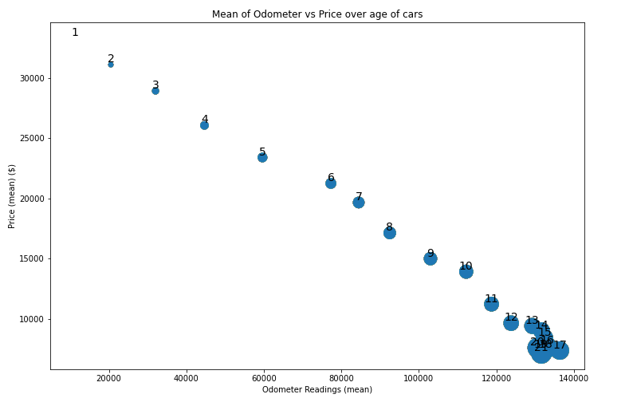
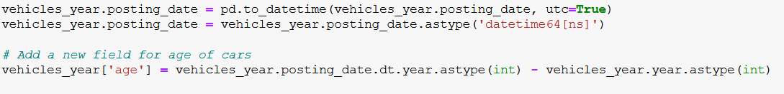
DATA CLEANING & VISUALIZATION
Price vs Odometer vs Age
if we compare the age of the car with price, we can see that as the model becomes older, price decreases. Similarly for the cars that are driven more are less expensive.

Slide 18
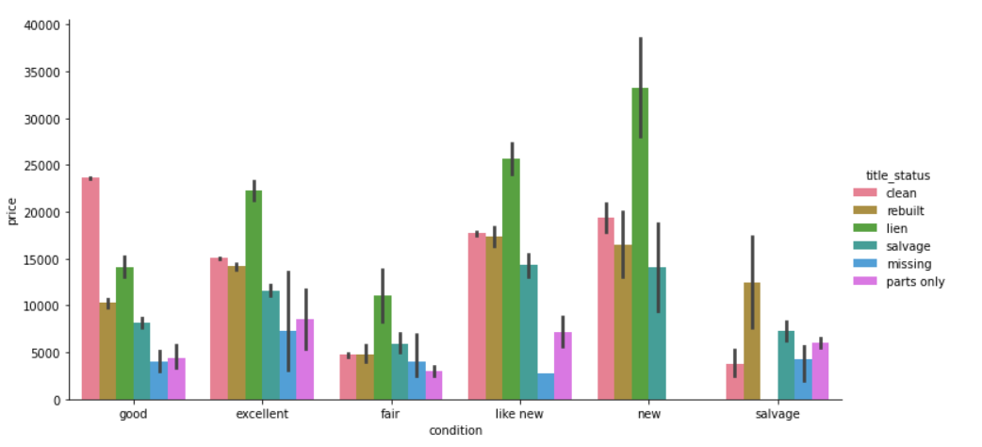
DATA CLEANING & VISUALIZATION
Price vs condition vs title_status
Clean - No accident
salvage - repair costs 40% of vehicle
rebuilt - can be auctioned
lien - loan is pending
missing - title is missing
parts only - beyond repair

Slide 19
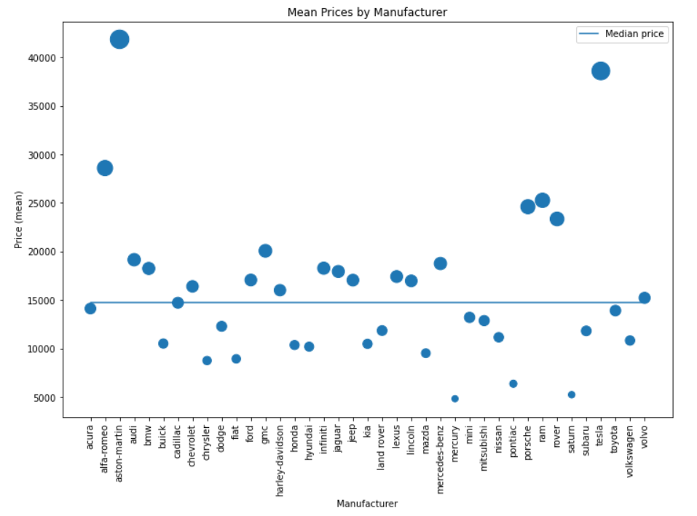
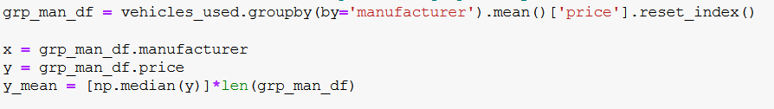
DATA CLEANING & VISUALIZATION
Mean Price vs Manufacturer
It is evident that luxury cars are expensive over cheap manufactured one’s

Slide 20
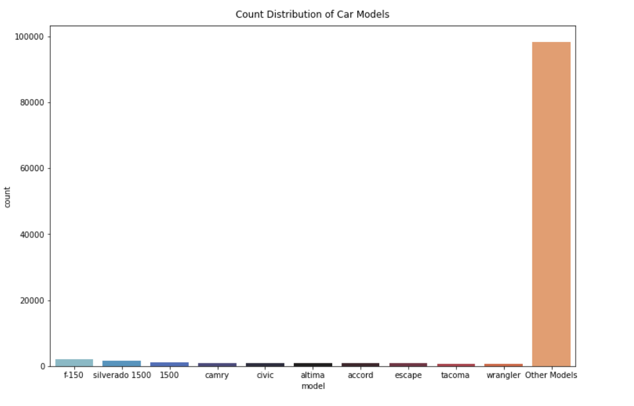
DATA CLEANING & VISUALIZATION
Price vs Models
Model feature has the highest cardinality among all the features

Slide 21
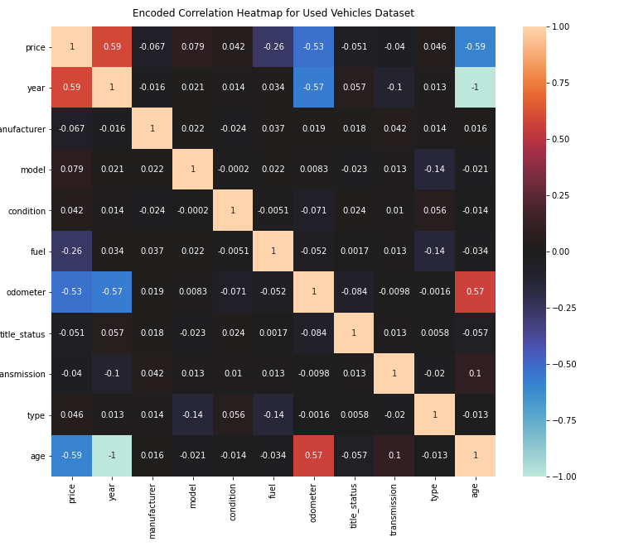
CORRELATION MATRIX
Using correlation matrix, we see that price is positively correlated with year and negatively with age, odometer. We don’t have any feature that is highly correlated, so won’t be dropping any feature at this stage.

Slide 22

FEATURE ENGINEERING
Derived Features:
Age = Posted date – Model year
Train and test data:
Train data = 70%
Test data= 30%
Label Encoding
To convert our Categorical variables into Numerical variables

Slide 23
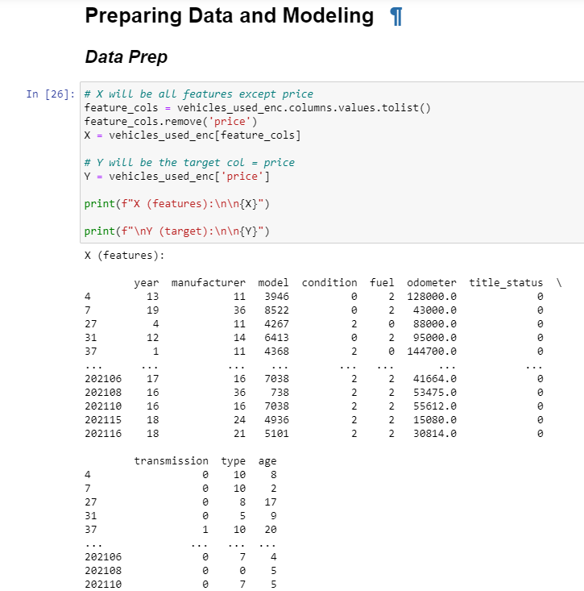
ML MODELS- CODE SNIPPETS

Slide 24
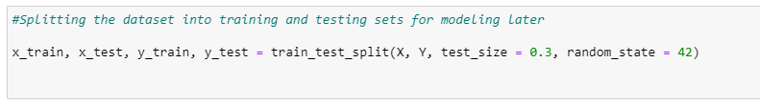
ML MODELS- CODE SNIPPETS
Splitting the data into training and testing

Slide 25
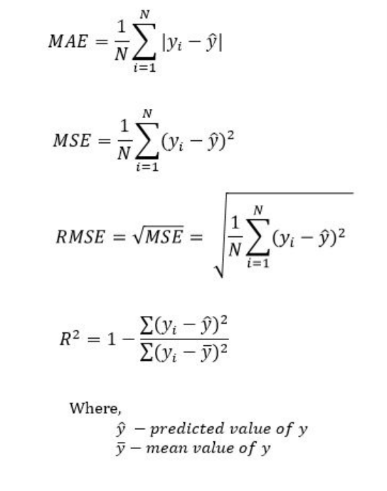
PERFORMANCE METRICS
MAE (Mean absolute error) represents the difference between the original and predicted values extracted by averaged the absolute difference over the data set.
MSE (Mean Squared Error) represents the difference between the original and predicted values extracted by squared the average difference over the data set.
RMSE (Root Mean Squared Error) is the error rate by the square root of MSE.
R-squared (Coefficient of determination) represents the coefficient of how well the values fit compared to the original values. The value from 0 to 1 interpreted as percentages. The higher the value is, the better the model

Slide 26
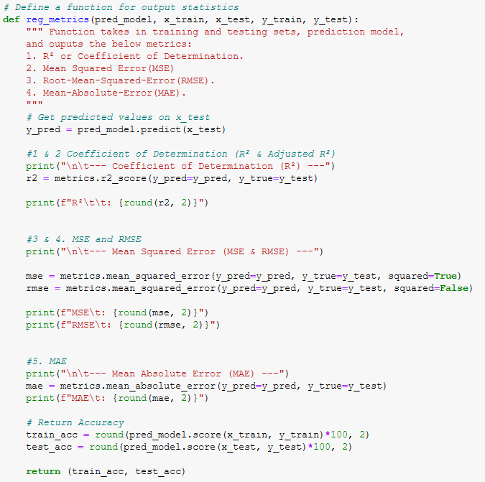
ML MODELS- CODE SNIPPETS
Defining the performance metrics

Slide 27
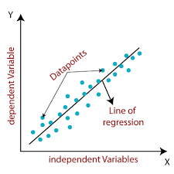
ML MODELS
LINEAR REGRESSION
It is a statistical model used to predict the relationship between independent and dependent variables
How closely x and y are closely correlated
Predict future y values for a given x value

Slide 28
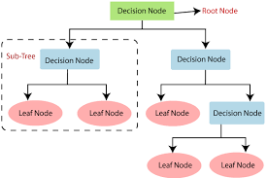
ML MODELS
DECISION TREE
It works by splitting the data into tree-like pattern
Predicting the output value of a set of features

Slide 29
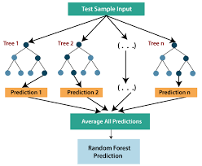
ML MODELS
RANDOM FOREST
Each tree is created from a different sample of rows and at each node,
Each of the trees makes its own individual prediction.
These predictions are then averaged to produce a single result.

Slide 30
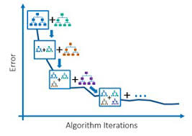
ML MODELS
GRADIENT BOOSTING
Is used to fit the model which predicts the continuous value.
A loss function is optimized
A weaker learner makes prediction
An additive model to add weak learners to minimize the loss function

Slide 31
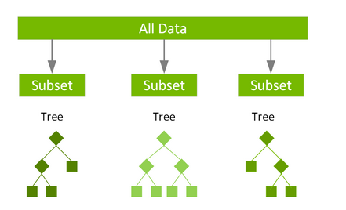
ML MODELS
XGBOOST
XGBoost, which stands for Extreme Gradient Boosting
Scalable, distributed gradient-boosted decision tree
Provides parallel tree boosting and is the leading machine learning library for regression, classification, and ranking problems.

Slide 32
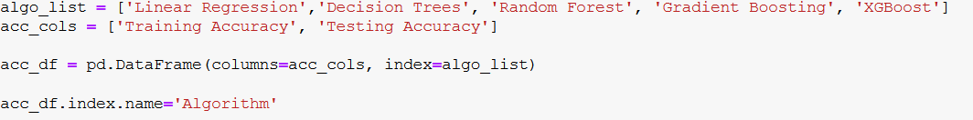
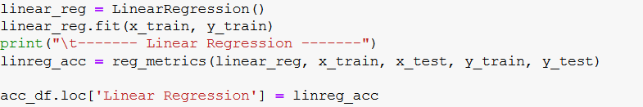
ML MODELS - Code snippet

Slide 33
SUMMARY OF PERFORMANCE METRICS
Models | R² | MSE | RMSE | MAE
LINEAR REGRESSION | 0.51 | 53709306.4 | 7328.661 | 5660.74
DECISION TREE REGRESSOR | 0.83 | 18524260 | 4303.98 | 2133.66
RANDOM FOREST REGRESSOR | 0.9 | 10436137.3 | 3230.5 | 1781.31
GRADIENT BOOSTING REGRESSOR | 0.76 | 26478883.5 | 5145.76 | 3602.39
XGBOOST REGRESSOR | 0.89 | 11946808 | 3456.42 | 2290.13

Slide 34
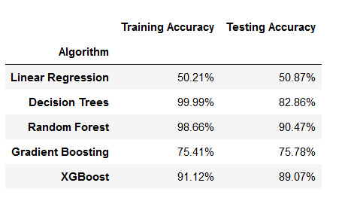
ACCURACY OF MODEL PERFORMANCE

Slide 35
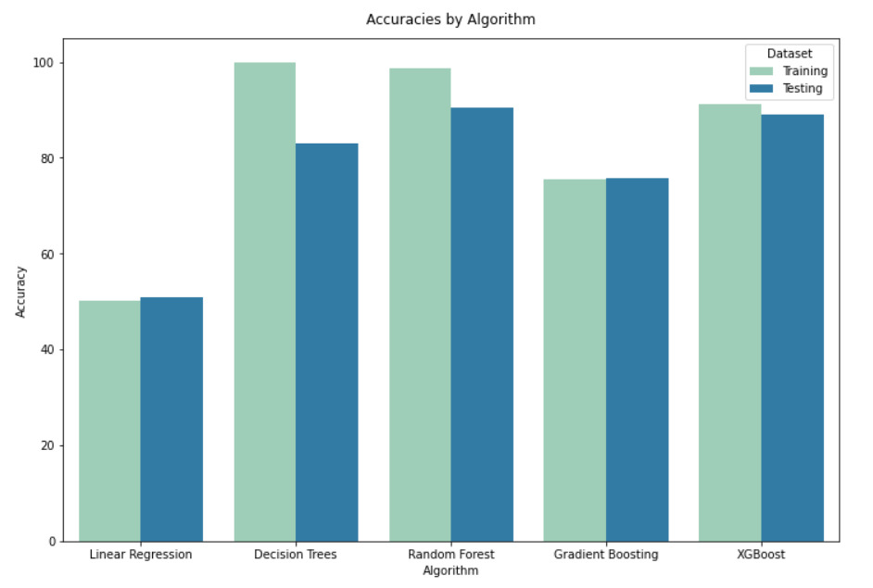
GRAPHICAL REPRESENTATION OF ACCURACIES OF MODEL PERFORMANCE

Slide 36
CONCLUSION
Linear Regression - Both training and test accuracies are low. High bias
Decision Tree - Model shows high training accuracy but low test accuracy. High Variance
Random Forest - Variance is reduced compared to DT. Significant Accuracy
Gradient Boosting - Generalized but high bias compared to RF & DT
XGBoost - Low variance as compared to RF & DT but falls marginally in test accuracy
RANDOM FOREST HAS BEST TEST ACCURACY BUT XGBOOST HAS LOWER VARIANCE WITH COMPARABLE TEST ACCURACY

Slide 37
REFERENCES
Moosavi, Sobhan, Mohammad Hossein Samavatian, Srinivasan Parthasarathy, and Rajiv Ramnath. “A Countrywide Traffic Accident Dataset.”, arXiv preprint arXiv:1906.05409 (2019)
https://phik.readthedocs.io/en/latest/
https://analyticsindiamag.com/hands-on-python-guide-to-optuna-a-new-hyperparameter-optimization-tool/
https://www.kaggle.com/austinreese/craigslist-carstrucks-data
https://www.appliedaicourse.com/

Slide 38

THANK YOU FOR LISTENING

